Slide 1

SPARE PARTS TO ONLINE STORE
ABOUT
TOPIC
SCOPE
INTRO
AIMS
PROBLEM
TOOLS
SOFTWARE
PROJECT PRESENTATION
HIGHER NATIONAL DIPLOMA IN INFORMATION TECHNOLOGY TANGALLE
PROJECT PROPOSAL

Slide 2

Group Number : 6
ABOUT
TOPIC
SCOPE
INTRO
AIMS
PROBLEM
TOOLS
SOFTWARE
D.S Munasinghe -TAN/IT/2021/F/0026
P.T Dilshan - TAN/IT/2021/F/0028
A.K.C Sandaru – TAN/IT/2021/F/0029
A.M.R.S Alahakon-TAN/IT/2021/F/0030
PROJECT PROPOSAL

Slide 3
Project Topic :
ABOUT
TOPIC
SCOPE
INTRO
AIMS
PROBLEM
TOOLS
SOFTWARE
ONLINE STORE TO
SPARE PARTS
Create web site to sell spare parts on vehicle
PROJECT PROPOSAL

Slide 4
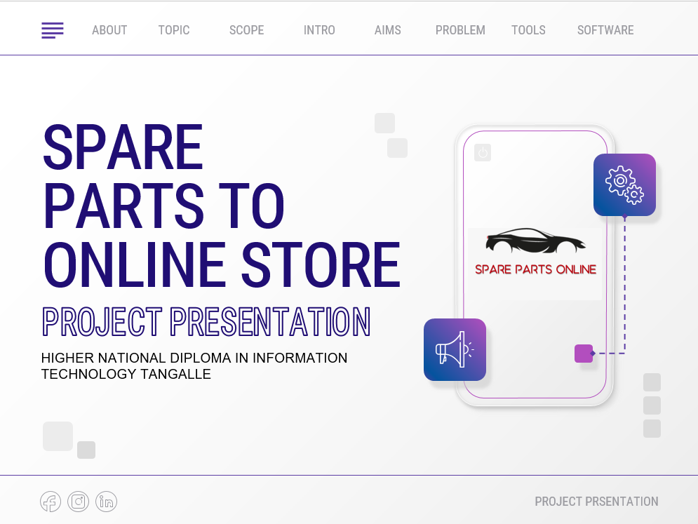
Project Scope :
ABOUT
TOPIC
SCOPE
INTRO
AIMS
PROBLEM
TOOLS
SOFTWARE
The scope of an online store to sell spare parts is wide, and it can cater to a broad range of customers' needs. The online store can offer spare parts for cars, including motorcycles. The store can also offer spare parts for some vehicle brands.
PROJECT PROPOSAL

Slide 5
Introduction :
ABOUT
TOPIC
SCOPE
INTRO
AIMS
PROBLEM
TOOLS
SOFTWARE
We are selling spare parts.
The topic of my presentation is "Spare Parts Sell Online Store". In today's fast-paced world, convenience and accessibility play a critical role in our decision-making process. However, finding replacement parts for your car equipment can be a daunting task, especially if you don't know where to look. That's why we've created an online store that offers high-quality spare parts for a wide range of products, including cars, and bike. Our online store provides a convenient and way to order the spare parts you need, without having to leave the comfort of your home or office. In this presentation, we will take a closer look at the features and benefits of our online store, and how it can help make your life easier by providing you with easy access to reliable, high-quality spare parts.
PROJECT PROPOSAL

Slide 6
Aims of the project
ABOUT
TOPIC
SCOPE
INTRO
AIMS
PROBLEM
TOOLS
SOFTWARE
The primary goal of e-commerce web site is to reach maximum customers at the right time to increase sales and profitability of the business.
Our goal is to Creating online web store to make it easy to buy high quality spare parts
Objectives of the project
Our main objective is to provide customers with a convenient and efficient platform to buy spare parts. We aim to:
Provide a comprehensive range of spare parts, both original and aftermarket, to our customers.
Create a user-friendly interface that simplifies the shopping process for our customers.
Ensure a secure and reliable payment system that guarantees the safety of our customer's financial information.
Provide prompt and personalized customer support to ensure customer satisfaction.
Increase our customer base and revenue through marketing and promotional strategies.
PROJECT PROPOSAL

Slide 7
Problem to solved :
ABOUT
TOPIC
SCOPE
INTRO
AIMS
PROBLEM
TOOLS
SOFTWARE
Determine our target audience: Identify the types of customers we want to attract to our online store. Understand their needs, preferences.
Research our competitors: Study our competitors' online stores, their product offerings, prices, and customer service. Look for ways to differentiate our online store from theirs.
Choose an e-commerce platform: Decide which e-commerce platform we will use to build and host your online store. Consider factors such as ease of use, scalability, customizability, and payment processing.
Develop our product catalog: Create a comprehensive product catalog that includes high-quality images, product descriptions, pricing, and availability.
Market our online store: Develop a marketing strategy that includes advertising, social media, search engine optimization (SEO.
Provide excellent customer service: Offer exceptional customer service, such as responding to customer inquiries promptly, providing product support, and handling returns and refunds efficiently.
By following these steps, we can create a successful online store for spare parts that attracts and retains customers, differentiates our from the competition, and maximizes our revenue potential.
PROJECT PROPOSAL

Slide 8
ABOUT
TOPIC
SCOPE
INTRO
AIMS
PROBLEM
TOOLS
SOFTWARE
Tools & Technologies :
Create Web Site
BUY DOMAIN & HOSTING
HTML
CSS
JAVA SCRIPT
Photoshop
Illustrator
MYSQL
PHP
Web Browser
PROJECT PROPOSAL

Slide 9
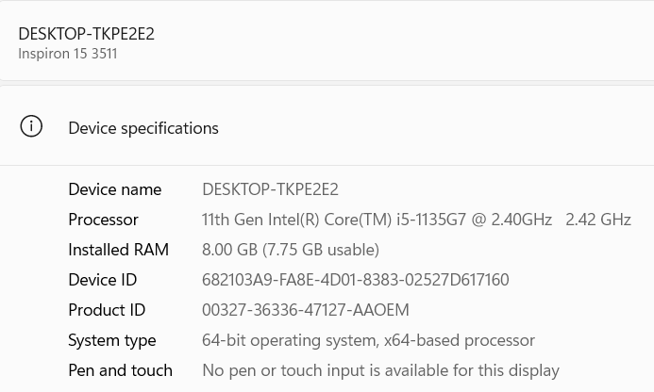
ABOUT
TOPIC
SCOPE
INTRO
AIMS
PROBLEM
TOOLS
SOFTWARE
Hardware Requirements
Software Requirements
Website design software: You'll need website design software to create a visually appealing and user-friendly online store.
Payment processing software: To accept payments online, you'll need payment processing software that integrates with your e-commerce platform. Popular options include PayPal, Stripe, and Square.
In addition to a computer or laptop with internet connectivity, an online store selling spare parts
Overall, creating and running an online store selling spare parts requires careful consideration of the hardware and software requirements involved, along with a focus on creating a positive user experience for customers.
PROJECT PROPOSAL

Slide 10
TOPIC
SCOPE
INTRO
AIMS
PROBLEM
TOOLS
SOFTWARE
TIME
Time Line
Phase 1: Planning and Research (2-3 weeks)
1. Market Research and Analysis (1 Week)
2. Define Project Goals and Objectives (1 Week)
3. Select Team Members and Assign Roles (1 Week)
Phase 2: Website Development (9 weeks)
1. Design and Develop Website (6-8 Weeks)
2. Implement Payment Processing System (1 Week)
3. Implement Logistics and Shipping Processes (1 Week)
4. Conduct Final Testing and Quality Assurance (1 Week)
Phase 3: Launch (2 weeks)
1. Develop and Implement Marketing Plan (1 Week)
2. Launch Online Store (1 Week)
PROJECT PROPOSAL

Slide 11
SCOPE
INTRO
AIMS
PROBLEM
TOOLS
SOFTWARE
TIME
REFERENCE
REFERENCES
https://www.quicksprout.com/how-to-create-a-website
https://www.w3schools.com/.
PROJECT PROPOSAL

Slide 12
THANKS!
INTRO
AIMS
PROBLEM
TOOLS
SOFTWARE
TIME
REFERENCE
THANKS
Do you have any questions?
dilshantharindu0612@gmail.com
070 460 8282
077 993 0726
077 071 0309
071 178 1607
PROJECT PROPOSAL

